Slide 1
Liquid-Crystal Display (LCD 16X2)
CSE 315
Peripherals & Interfacing
Abdullah Al Omar
Lecturer, CSE, UAP

Slide 2
What is LCD?
A Liquid Crystal Display (LCD) is a thin , flat panel display device used for electronically displaying information such as text ,images and moving picture.
LCD is used in Computer monitors, Televisions , Instrument panels, Gaming devices etc.
Polarization of lights is used here to display objects.
The LCDs have a parallel interface, meaning that the microcontroller has to manipulate several interface pins at once to control the display.

Slide 3
16*2 LCD
16×2 LCD is named so because; it has 16 Columns and 2 Rows. There are a lot of combinations available like, 8×1, 8×2, 10×2, 16×1, etc. but the most used one is the 16×2 LCD. So, it will have (16×2=32) 32 characters in total and each character will be made of 5×8 Pixel Dots

Slide 4
Why LCD?
Smaller size —LCDs occupy approximately 60 percent less space than CRT displays an important feature when office space is limited.
Lower power consumption—LCDs typically consume about half the power and emit much less heat than CRT displays.
Lighter weight —LCDs weight approximately 70 percent less than CRT displays of comparable size.
No electromagnetic fields —LCDs do not emit electromagnetic fields and are not susceptible to them. Thus, they are suitable for use in areas where CRTs cannot be used.
Longer life —LCDs have a longer useful life than CRTs

Slide 5
Features of 16×2 LCD
Operating Voltage is 4.7V to 5.3V
Current consumption is 1mA without backlight
Alphanumeric LCD display module, meaning can display alphabets and numbers
Consists of two rows and each row can print 16 characters.
Each character is build by a 5×8 pixel box
Can work on both 8-bit and 4-bit mode
It can also display any custom generated characters
Available in Green and Blue Backlight

Slide 6
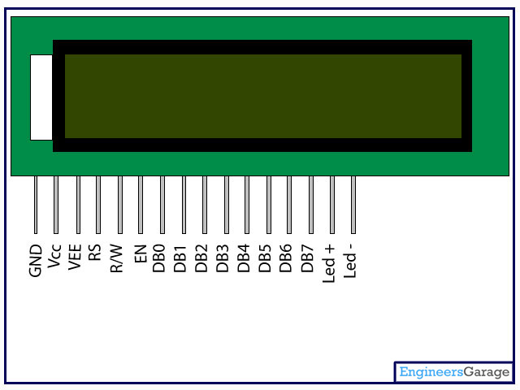
Pin Configuration:

Slide 7
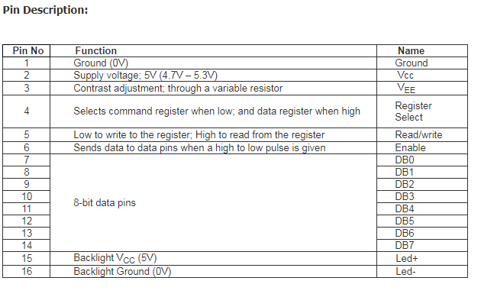

Slide 8
Working:
Liquid crystal display screen works on the principle of blocking light rather than emitting light. LCD's requires backlight as they do not emits light by them. We always use devices which are made up of LCD's displays which are replacing the use of cathode ray tube.

Slide 9
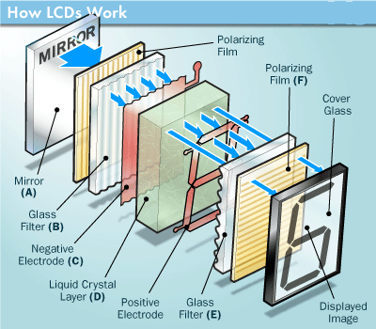

Slide 10
Coding:
#include <LiquidCrystal.h>
LiquidCrystal lcd(12, 11, 5, 4, 3, 2);
void setup() {
lcd.begin(16, 2);
lcd.print("hello UAP!");
}
void loop() { }

Slide 11
Required Components
Arduino
LM016L

Slide 12
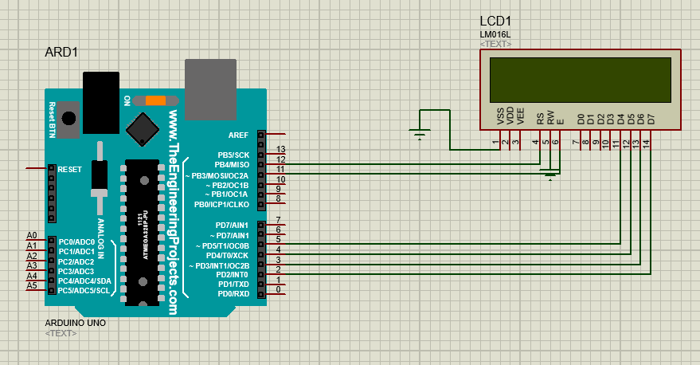
Proteus Integration:

Slide 13
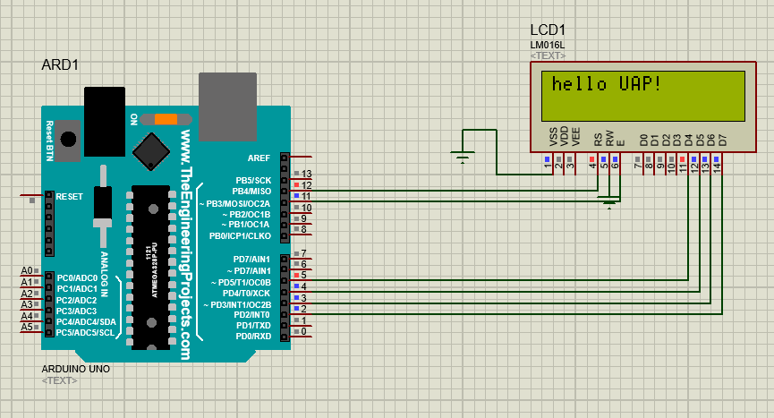
Proteus Integration:

Slide 14
Projects:
Temperature Controlled AC Home Appliances
Car Speed Detector Using Arduino.
Home Energy Monitor
Arduino Calculator.
Arduino Clock and so on.
Normal Game (Car and obstacle)

Slide 15


